Slide 1
Biodiesel Demand Outlook
Questions? Contact Jim Stark
972-281-4823 James.Stark@darlingii.com

Slide 2
Safe Harbor Statement
This presentation contains “forward-looking” statements that are subject to risks and uncertainties that could cause the actual results of Darling Ingredients Inc. (the “Company”) to differ materially from those expressed or implied in the statements. Statements that are not statements of historical facts are forward-looking statements and are made pursuant to the safe harbor provisions of the Private Securities Litigation Reform Act of 1995. Words such as “estimate,” “project,” “planned,” “contemplate,” “potential,” “possible,” “proposed,” “intend,” “believe,” “anticipate,” “expect,” “may,” “will,” “would,” “should,” “could” and similar expressions are intended to identify forward-looking statements. Forward-looking statements are based on the Company’s current expectations and assumptions regarding its business, the economy and other future conditions. The Company cautions readers that any such forward-looking statements it makes are not guarantees of future performance and that actual results may differ materially from anticipated results or expectations expressed in its forward-looking statements as a result of a variety of factors, including many that are beyond the Company’s control. These factors include, among others, existing and unknown future limitations on the ability of the Company's direct and indirect subsidiaries to make their cash flow available to the Company for payments on the Company's indebtedness or other purposes; global demands for bio-fuels and grain and oilseed commodities, which have exhibited volatility, and can impact the cost of feed for cattle, hogs and poultry, thus affecting available rendering feedstock and selling prices for the Company’s products; reductions in raw material volumes available to the Company due to weak margins in the meat production industry as a result of higher feed costs, reduced consumer demand or other factors, reduced volume from food service establishments, or otherwise; reduced demand for animal feed; reduced finished product prices, including a decline in fat and used cooking oil finished product prices; changes to worldwide government policies relating to renewable fuels and greenhouse gas(“GHG”) emissions that adversely affect programs like the U.S. government’s renewable fuel standard, low carbon fuel standards (“LCFS”) and tax credits for biofuels both in the Unites States and abroad; possible product recall resulting from developments relating to the discovery of unauthorized adulterations to food or food additives; the occurrence of 2009 H1N1 flu (initially known as “Swine Flu”), Highly pathogenic strains of avian influenza (collectively known as “Bird Flu”), severe acute respiratory syndrome (“SARS”), bovine spongiform encephalopathy (or "BSE"), porcine epidemic diarrhea ("PED") or other diseases associated with animal origin in the United States or elsewhere, such as the outbreak of African Swine Fever (“ASF”) in China and elsewhere; escalation in the outbreak of the coronavirus; unanticipated costs and/or reductions in raw material volumes related to the Company’s compliance with the existing or unforeseen new U.S. or foreign (including, without limitation, China) regulations (including new or modified animal feed, Bird Flu, SARS, PED, BSE or ASF or similar or unanticipated regulations) affecting the industries in which the Company operates or its value added products; risks associated with the DGD Joint Venture, including possible unanticipated operating disruptions and issues relating to the announced expansion project; risks and uncertainties relating to international sales and operations, including imposition of tariffs, quotas, trade barriers and other trade protections imposed by foreign countries; difficulties or a significant disruption in our information systems or failure to implement new systems and software successfully, including our ongoing enterprise resource planning project; risks relating to possible third party claims of intellectual property infringement; increased contributions to the Company’s pension and benefit plans, including multiemployer and employer-sponsored defined benefit pension plans as required by legislation, regulation or other applicable U.S. or foreign law or resulting from a U.S. mass withdrawal event; bad debt write-offs; loss of or failure to obtain necessary permits and registrations; continued or escalated conflict in the Middle East, North Korea, Ukraine or elsewhere; uncertainty regarding the likely exit of the U.K. from the European Union; and/or unfavorable export or import markets. These factors, coupled with volatile prices for natural gas and diesel fuel, climate conditions, currency exchange fluctuations, general performance of the U.S. and global economies, disturbances in world financial, credit, commodities and stock markets, and any decline in consumer confidence and discretionary spending, including the inability of consumers and companies to obtain credit due to lack of liquidity in the financial markets, among others, could cause actual results to vary materially from the forward-looking statements included in this presentation or negatively impact the Company's results of operations. Among other things, future profitability may be affected by the Company’s ability to grow its business, which faces competition from companies that may have substantially greater resources than the Company. The Company’s announced share repurchase program may be suspended or discontinued at any time and purchases of shares under the program are subject to market conditions and other factors, which are likely to change from time to time. Other risks and uncertainties regarding Darling Ingredients Inc., its business and the industries in which it operates are referenced from time to time in the Company’s filings with the Securities and Exchange Commission. Darling Ingredients Inc. is under no obligation to (and expressly disclaims any such obligation to) update or alter its forward-looking statements whether as a result of new information, future events or otherwise.

Slide 3
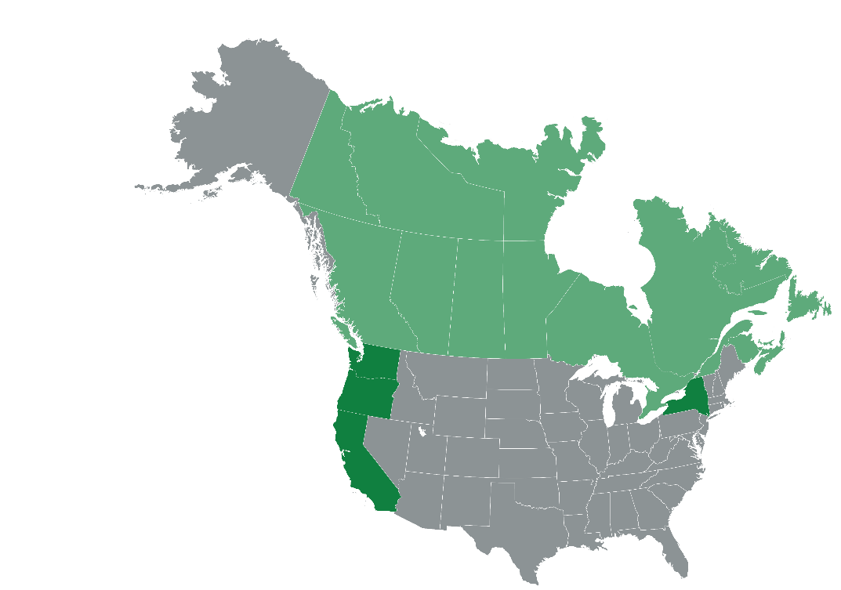
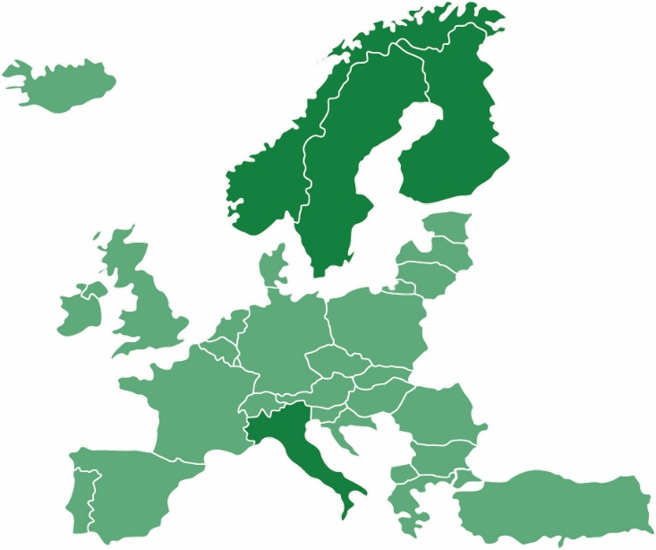

Low Carbon Fuel Standards are Growing
North America potential RD demand including California is approx. 2 billion gallons annually in the next 5 years
Canada
Finland
30 fewer Mt CO2*
Clean Fuels
Standard under
development
30% liquid renewable road fuels
Washington
Sweden
Considering LCFS similar to CA
70% less CO2*
2020 Sweden target 21% GHG reduction mandate for diesel
Oregon
California
New York
EU
Italy
Norway
Considering LCFS similar to CA
20% less carbon intensity
~ 4.2b gallons of diesel annually
Considering LCFS similar to CA
EU target of 14% renewable energy in transport in 2030
22%* renewable energy in transport
40%* biofuels in
transport; 30%
biofuels in aviation
* Preliminary 2030 targets
Renewable Diesel produced from animal fats/used cooking oils and
distillers corn oil, reduces Green House Gas emissions by up to 85%

Slide 4

And yet, we are in the early stages of demand for RD
California Average
Carbon Price $/MT, UCO
Spot price
February 25, 2020
$168.29
$100.33
$100.33
$52.11
Source: California Air Resources Board (CARB); The Jacobsen

Slide 5
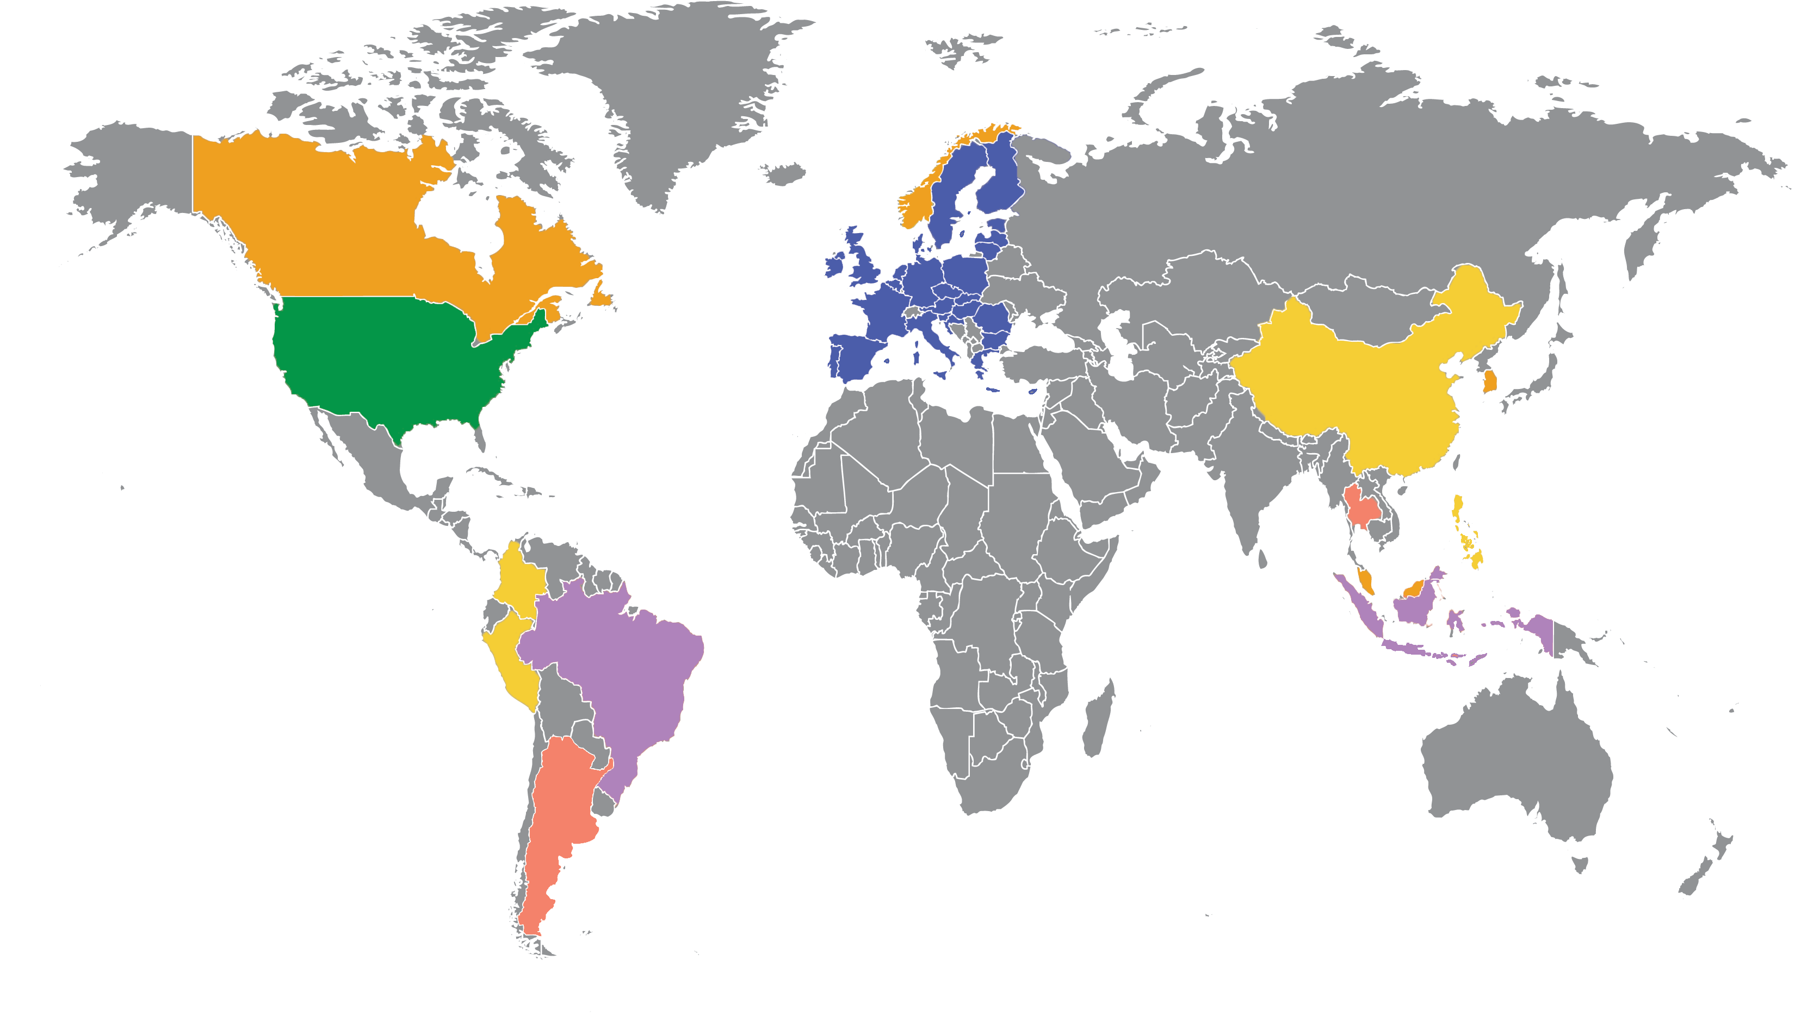
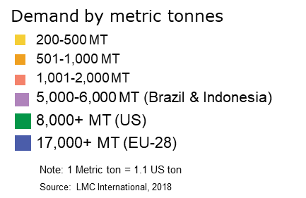
The world will also produce renewable diesel… but this is positive for Darling’s core business
180,000 MT
capacity
1
3
620,000 MT
capacity
1
1,000,000 MT
capacity
1
500,000 MT
capacity
4
1,455,000 MT
capacity
1
20,000 MT
capacity
2
240,000 MT
capacity
1
1,000,000 MT
capacity
1
230,000 MT
capacity
1
400,000 MT
capacity
1
1,160,000 MT
capacity
*NOTE: Number inside fuel pump icon is number
of renewable diesel facilities in that country
Source: Greenea.com

Slide 6

Fuel Segment (includes Diamond Green Diesel JV consolidated EBITDA)
Fuel Segment (Includes Diamond Green Diesel JV consolidated EBITDA)
Key Drivers:
Combined adjusted EBITDA of $311.2 million, with DGD earning $2.57 per gallon on 77.1 million gallons sold for Q4-19 and $2.25 per gallon for all 2019. Includes the $1.00 blender’s tax credit approved in Dec. 2019
Diamond Green II expansion remains on schedule to be completed in the fourth quarter of 2021. Adding 400 million gallons of annual capacity, gives DGD 675 million gallons of renewable diesel production plus an additional 60 million gallons of renewable naphtha
Blenders Tax Credit (BTC) in place for 2020, 2021 and 2022
(1) Includes Fuel Segment EBITDA and Darling's share of DGD EBITDA.
* Excludes feed stock (raw material) processed at the DGD joint venture.

Slide 7
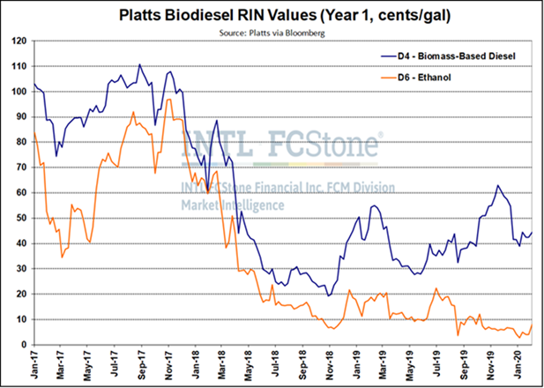
California LCFS & RIN value history
California LCFS & RIN value history
Source: https://ww3.arb.ca.gov/fuels/lcfs/credit/lrtweeklycreditreports.htm

Slide 8
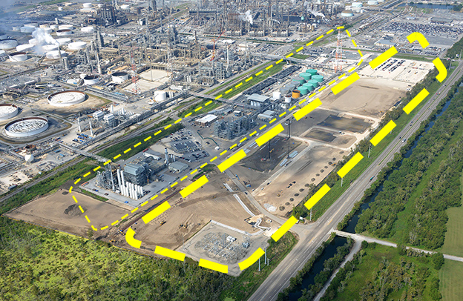
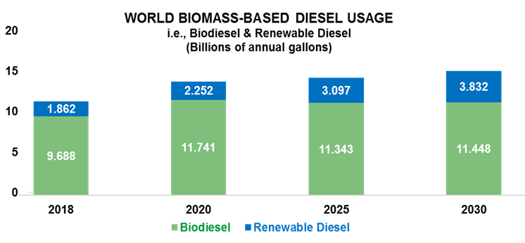
Global biofuel demand is growing… so is DGD
Biomass-based diesel usage is projected to increase due to further implementation of GHG reducing programs & mandates
However, majority of growth is expected to come from Renewable Diesel
EU and U.S. key drivers (but not the only) for Renewable Diesel growth
Diamond II Expansion
Phase 3 expansion approved
parallel independent plant
to bring total annual production to
675 million gallons of renewable diesel plus
50-60 million gallons additional renewable naphtha

